Slide 1
Quick Warm-Up
Suppose we have a biased coin that comes up heads with some unknown probability p; how can we use it to produce random bits with probabilities of exactly 0.5 for 0 and 1?

Slide 2
Quick Warm-Up
Suppose we have a biased coin that comes up heads with some unknown probability p; how can we use it to produce random bits with probabilities of exactly 0.5 for 0 and 1?
Answer (von Neumann):
Flip coin twice, repeat until the outcomes are different
HT = 0, TH = 1, each has probability p(1-p)

Slide 3
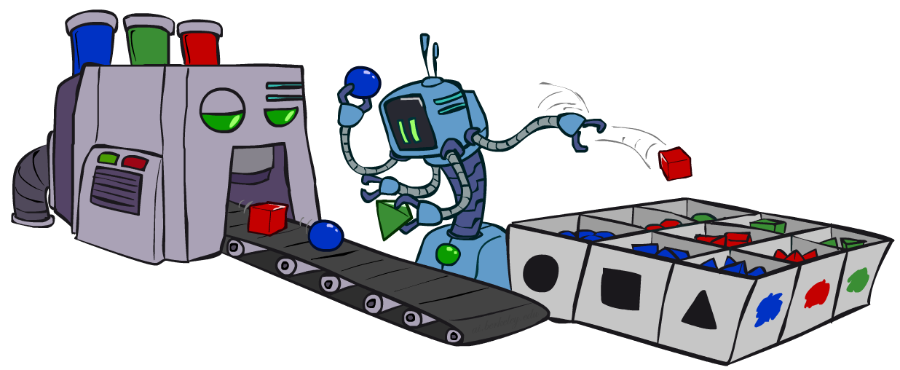
CS 188: Artificial Intelligence
Bayes Nets: Approximate Inference
Instructors: Stuart Russell and Dawn Song
University of California, Berkeley
Notes:
Please retain proper attribution, including the reference to ai.berkeley.edu. Thanks!

Slide 4

Sampling
Basic idea
Draw N samples from a sampling distribution S
Compute an approximate posterior probability
Show this converges to the true probability P
Why sample?
Often very fast to get a decent approximate answer
The algorithms are very simple and general (easy to apply to fancy models)
They require very little memory (O(n))
They can be applied to large models, whereas exact algorithms blow up

Slide 5
Example
Suppose you have two agent programs A and B for Monopoly
What is the probability that A wins?
Method 1:
Let s be a sequence of dice rolls and Chance and Community Chest cards
Given s, the outcome V(s) is determined (1 for a win, 0 for a loss)
Probability that A wins is
Problem: infinitely many sequences s !
Method 2:
Sample N sequences from P(s) , play N games (maybe 100)
Probability that A wins is roughly 1/N ∑_{i} V(s_{i}) i.e., fraction of wins in the sample
∑_{s} P(s) V(s)

Slide 6

Sampling basics: discrete (categorical) distribution
To simulate a biased d-sided coin P(x):
Step 1: Get sample u from uniform distribution over [0, 1)
E.g. random() in python
Step 2: Convert this sample u into an outcome for the given distribution by associating each outcome x_{i} with a P(x_{i})-sized sub-interval of [0,1)
Example
If random() returns u = 0.83, then the sample is C = blue
E.g, after sampling 8 times:
C | P(C)
red | 0.6
green | 0.1
blue | 0.3
0.0 ≤ u < 0.6, → C=red
0.6 ≤ u < 0.7, → C=green
0.7 ≤ u < 1.0, → C=blue
0.6
0.1
0.3

Slide 7
Sampling in Bayes nets
Prior sampling
Rejection sampling
Likelihood weighting
Gibbs sampling

Slide 8
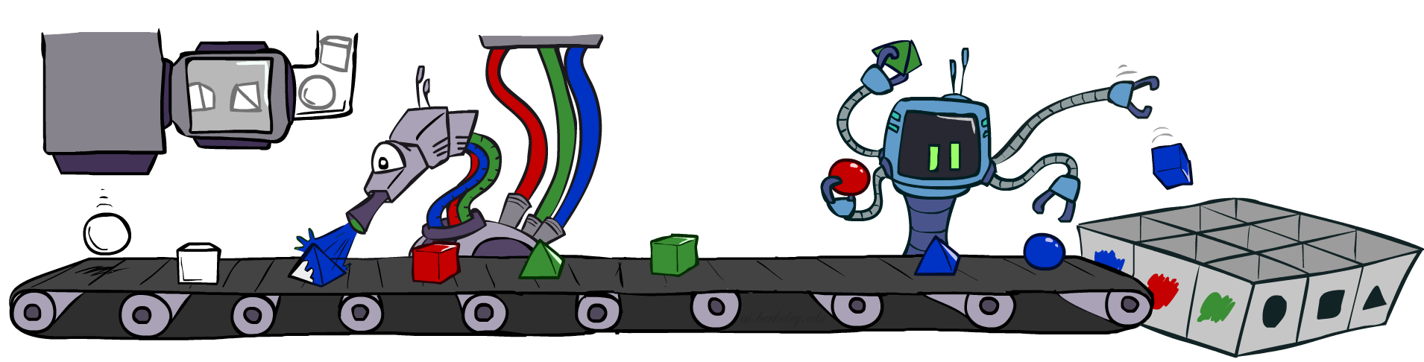
Prior sampling
Shape
Color

Slide 9
Prior sampling
P(C)
c | 0.5
¬c | 0.5
Cloudy
P(S | C)
Cloudy
P(R | C)
c | s | 0.1
 | ¬s | 0.9
¬c | s | 0.5
 | ¬s | 0.5
c | r | 0.8
 | ¬r | 0.2
¬c | r | 0.2
 | ¬r | 0.8
Sprinkler
Sprinkler
Rain
Rain
P(W | S,R)
WetGrass
WetGrass
Samples:
s | r | w | 0.99
 |  | ¬w | 0.01
 | ¬r | w | 0.90
 |  | ¬w | 0.10
¬s | r | w | 0.90
 |  | ¬w | 0.10
 | ¬r | w | 0.01
 |  | ¬w | 0.99
c, ¬s, r, w
¬c, s, ¬r, w
…
S_{PS}(c,¬s, r, w) =

Slide 10
Prior sampling
For i=1, 2, …, n (in topological order)
Sample X_{i} from P(X_{i} | parents(X_{i}))
Return (x₁, x₂, …, x_{n})

Slide 11
Prior Sampling
This process generates samples with probability:
S_{PS}(x₁,…,x_{n}) =
…i.e. the BN’s joint probability
Let the number of samples of an event be N_{PS}(x₁,…,x_{n})
Estimate from N samples is Q_{N}(x₁,…,x_{n}) = N_{PS}(x₁,…,x_{n})/N
Then lim_{N→∞} Q_{N}(x₁,…,x_{n}) = lim_{N→∞} N_{PS}(x₁,…,x_{n})/N
= S_{PS}(x₁,…,x_{n})
= P(x₁,…,x_{n})
I.e., the sampling procedure is consistent
∏_{i} P(x_{i} | parents(X_{i})) = P(x₁,…,x_{n})

Slide 12
Example
We’ll get a bunch of samples from the BN:
c, ¬s, r, w
c, s, r, w
¬c, s, r, ¬w
c, ¬s, r, w
¬c, ¬s, ¬r, w
If we want to know P(W)
We have counts <w:4, ¬w:1>
Normalize to get P(W) = <w:0.8, ¬w:0.2>
This will get closer to the true distribution with more samples
C
S
R
W

Slide 13
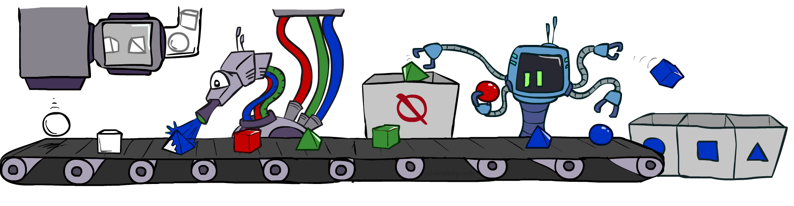
Rejection sampling

Slide 14
Rejection sampling
A simple application of prior sampling for estimating conditional probabilities
Let’s say we want P(C| r, w) = α P(C, r, w)
For these counts, samples with ¬r or ¬w are not relevant
So count the C outcomes for samples with r, w and reject all other samples
This is called rejection sampling
It is also consistent for conditional probabilities (i.e., correct in the limit)
C
S
R
W
c, ¬s, r, w
c, s, ¬r
¬c, s, r, ¬w
c, ¬s, ¬r
¬c, ¬s, r, w

Slide 15
Rejection sampling
Input: evidence e₁,..,e_{k}
For i=1, 2, …, n
Sample X_{i} from P(X_{i} | parents(X_{i}))
If x_{i} not consistent with evidence
Reject: Return, and no sample is generated in this cycle
Return (x₁, x₂, …, x_{n})

Slide 16
Car Insurance: P(PropertyCost | e)

Slide 17
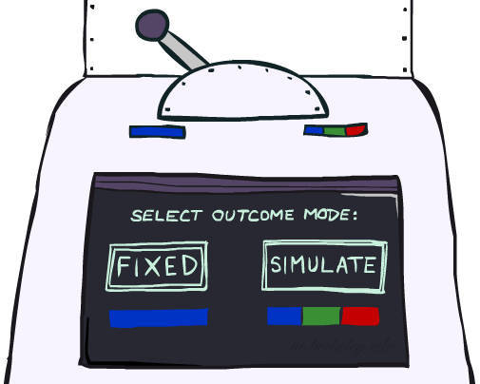
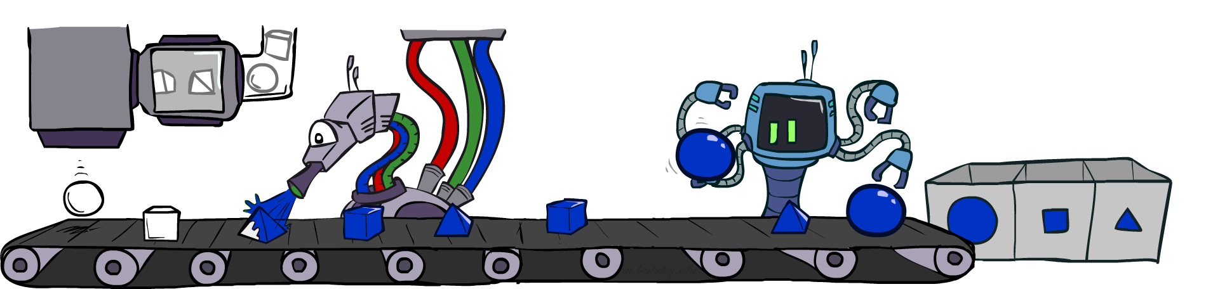
Likelihood weighting

Slide 18
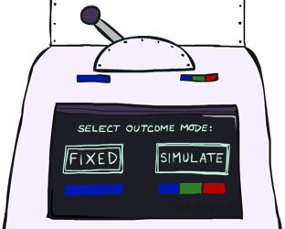


Likelihood weighting
Problem with rejection sampling:
If evidence is unlikely, rejects lots of samples
Evidence not exploited as you sample
Consider P(Shape|Color=blue)
Idea: fix evidence variables, sample the rest
Problem: sample distribution not consistent!
Solution: weight each sample by probability of evidence variables given parents
pyramid, green
pyramid, red
sphere, blue
cube, red
sphere, green
pyramid, blue
pyramid, blue
sphere, blue
cube, blue
sphere, blue
Shape
Color
Shape
Color

Slide 19
Likelihood Weighting
P(C)
c | 0.5
¬c | 0.5
P(S | C)
Cloudy
P(R | C)
Cloudy
c | s | 0.1
 | ¬s | 0.9
¬c | s | 0.5
 | ¬s | 0.5
c | r | 0.8
 | ¬r | 0.2
¬c | r | 0.2
 | ¬r | 0.8
Sprinkler
Sprinkler
Rain
Rain
P(W | S,R)
WetGrass
Samples:
WetGrass
s | r | w | 0.99
 |  | ¬w | 0.01
 | ¬r | w | 0.90
 |  | ¬w | 0.10
¬s | r | w | 0.90
 |  | ¬w | 0.10
 | ¬r | w | 0.01
 |  | ¬w | 0.99
c
, s, , w
r
w = 1.0
x 0.1
x 0.99

Slide 20
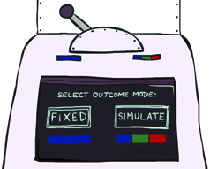
Likelihood weighting
Input: evidence e₁,..,e_{k}
w = 1.0
for i=1, 2, …, n
if X_{i} is an evidence variable
x_{i} = observed value_{i} for X_{i}
Set w = w * P(x_{i} | parents(X_{i}))
else
Sample x_{i} from P(X_{i} | parents(X_{i}))
return (x₁, x₂, …, x_{n}), w

Slide 21
Likelihood weighting is consistent
Sampling distribution if Z sampled and e fixed evidence
S_{WS}(z,e) = ∏_{j} P(z_{j} | parents(Z_{j}))
Now, samples have weights
w(z,e) = ∏_{k} P(e_{k} | parents(E_{k}))
Together, weighted sampling distribution is consistent
S_{WS}(z,e) ⋅ w(z,e) = ∏_{j} P(z_{j} | parents(Z_{j})) ∏_{k} P(e_{k} | parents(E_{k}))
= P(z,e)
Likelihood weighting is an example of importance sampling
Would like to estimate some quantity based on samples from P
P is hard to sample from, so use Q instead
Weight each sample x by P(x)/Q(x)
Cloudy
C
S
R
W

Slide 22
Car Insurance: P(PropertyCost | e)

Slide 23
Likelihood weighting
Likelihood weighting is good
All samples are used
The values of downstream variables are influenced by upstream evidence
Likelihood weighting still has weaknesses
The values of upstream variables are unaffected by downstream evidence
E.g., suppose evidence is a video of a traffic accident
With evidence in k leaf nodes, weights will be O(2^{-k})
With high probability, one lucky sample will have much larger weight than the others, dominating the result
We would like each variable to “see” all the evidence!

Slide 24
Quiz
Suppose I perform a random walk on a graph, following the arcs out of a node uniformly at random. In the infinite limit, what fraction of time do I spend at each node?
Consider these two examples:
a
a
b
c
b
c

Slide 25
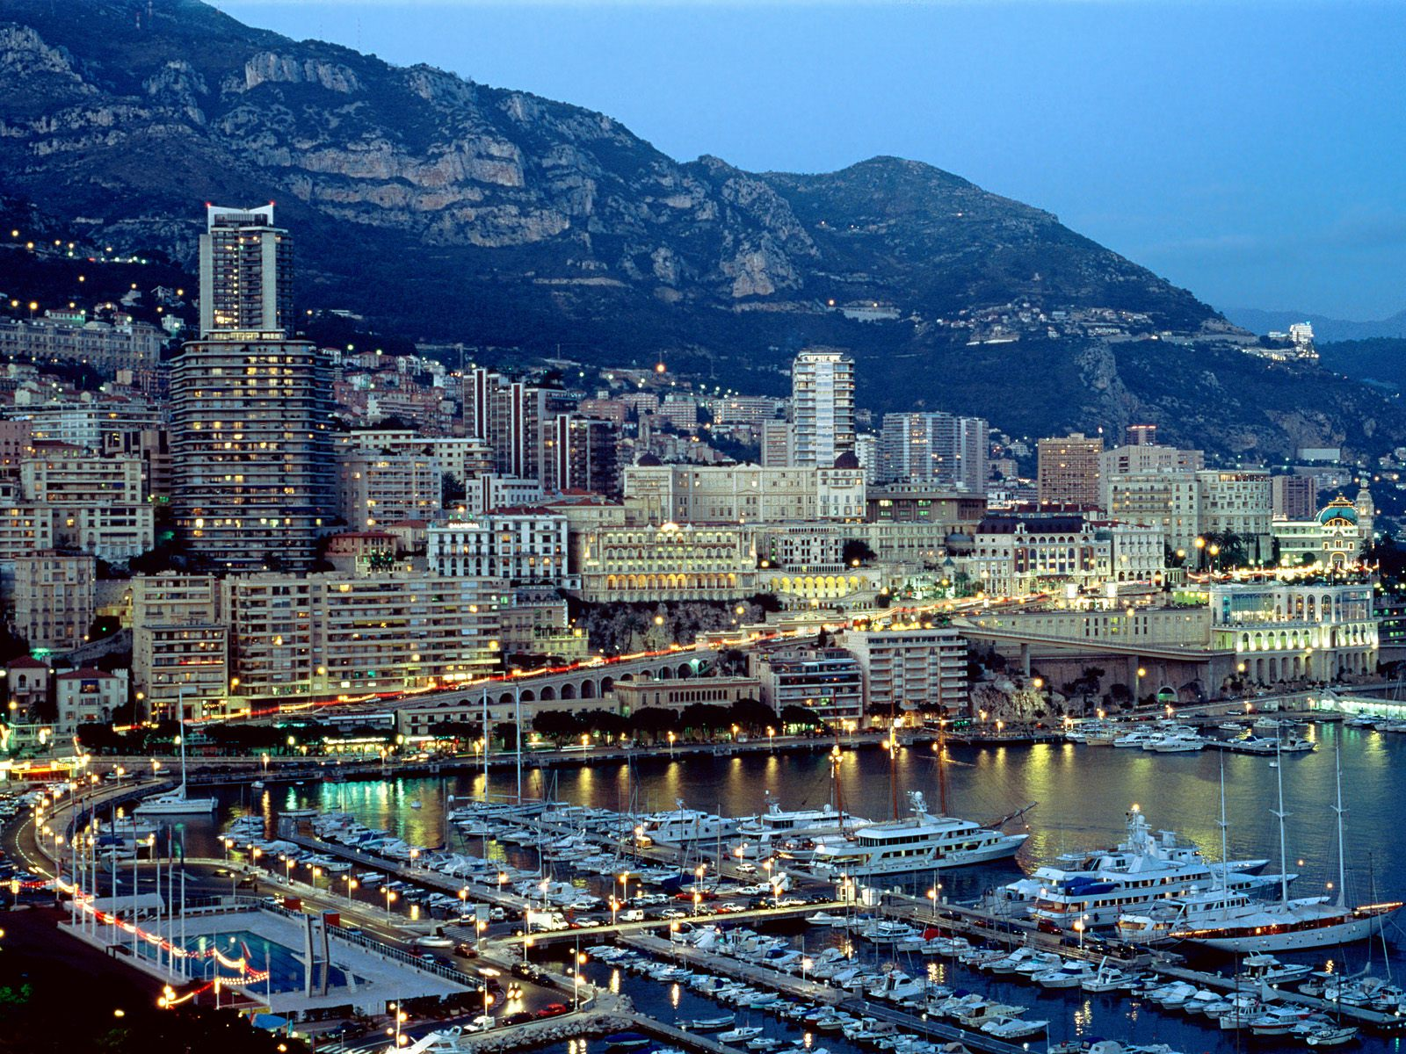
Markov Chain Monte Carlo
MCMC (Markov chain Monte Carlo) is a family of randomized algorithms for approximating some quantity of interest over a very large state space
Markov chain = a sequence of randomly chosen states (“random walk”), where each state is chosen conditioned on the previous state
Monte Carlo = a very expensive city in Monaco with a famous casino
Monte Carlo = an algorithm (usually based on sampling) that has some probability of producing an incorrect answer
MCMC = wander around for a bit, average what you see

Slide 26
Gibbs sampling
A particular kind of MCMC
States are complete assignments to all variables
(Cf local search: closely related to simulated annealing!)
Evidence variables remain fixed, other variables change
To generate the next state, pick a variable and sample a value for it conditioned on all the other variables: X_{i}’ ~ P(X_{i} | x₁,..,x_{i-1},x_{i+1},..,x_{n})
Will tend to move towards states of higher probability, but can go down too
In a Bayes net, P(X_{i} | x₁,..,x_{i-1},x_{i+1},..,x_{n}) = P(X_{i} | markov_blanket(X_{i}))
Theorem: Gibbs sampling is consistent*
Provided all Gibbs distributions are bounded away from 0 and 1 and variable selection is fair

Slide 27
Advantages of MCMC
Samples soon begin to reflect all the evidence in the network
Eventually they are being drawn from the true posterior!

Slide 28
Car Insurance: P(PropertyCost | e)

Slide 29
Car Insurance: P(PropertyCost | e)

Slide 30
Gibbs sampling algorithm
Repeat many times
Sample a non-evidence variable X_{i} from
P(X_{i} | x₁,..,x_{i-1},x_{i+1},..,x_{n}) = P(X_{i} | markov_blanket(X_{i}))
= α P(X_{i} | parents (X_{i})) ∏_{j} P(y_{j} | parents(Y_{j}))

Slide 31
Gibbs Sampling Example: P( S | r)
Step 1: Fix evidence
R = true
Step 3: Repeat
Choose a non-evidence variable X
Resample X from P(X | markov_blanket(X))
Step 2: Initialize other variables
Randomly
C
C
S
r
S
r
W
W
C
C
C
C
C
C
S
r
S
r
S
r
S
r
S
r
S
r
W
W
W
W
W
W
Sample S ~ P(S | c, r, ¬w)
Sample C ~ P(C | s, r)
Sample W ~ P(W | s, r)
Notes:
Better animation

Slide 32
Markov chain given s, w

Slide 33
Gibbs sampling and MCMC in practice
The most commonly used method for large Bayes nets
See, e.g., BUGS, JAGS, STAN, infer.net, BLOG, etc.
Can be compiled to run very fast
Eliminate all data structure references, just multiply and sample
~100 million samples per second on a laptop
Can run asynchronously in parallel (one processor per variable)
Many cognitive scientists suggest the brain runs on MCMC

Slide 34
Consistency of Gibbs (see AIMA 13.4.2 for details)
Suppose we run it for a long time and predict the probability of reaching any given state at time t: π_{t}(x₁,...,x_{n}) or π_{t}(x)
Each Gibbs sampling step (pick a variable, resample its value) applied to a state x has a probability k(x’ | x) of reaching a next state x’
So π_{t+1}(x’) = ∑_{x} k(x’ | x) π_{t}(x) or, in matrix/vector form π_{t+1} = Kπ_{t}
When the process is in equilibrium π_{t+1} = π_{t} = π so Kπ = π
This has a unique* solution π = P(x₁,...,x_{n} | e₁,...,e_{k})
* Markov chain must be ergodic, i.e., completely connected and aperiodic
Satisfied if all probabilities are bounded away from 0 and 1
So for large enough t the next sample will be drawn from the true posterior
“Large enough” depends on CPTs in the Bayes net; takes longer if nearly deterministic

Slide 35

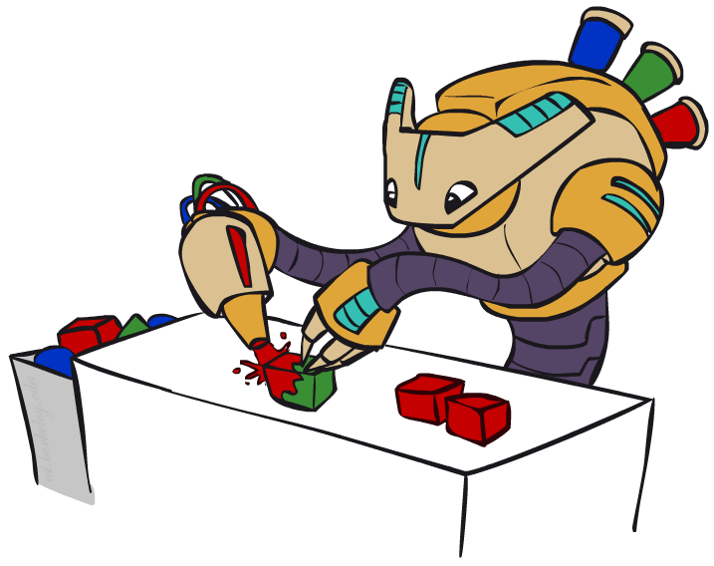
Bayes Net Sampling Summary
Prior Sampling P :
Generate complete samples from P(x₁,…,x_{n})
Likelihood Weighting P(Q | e) :
Weight samples by how well they predict e
Rejection Sampling P(Q | e) :
Reject samples that don’t match e
Gibbs sampling P(Q | e) :
Wander around in e space
Average what you see

